Slide 1
Decentralized EXCHAnGES
Blockchain Meetup Hannover 2018-04-24

Slide 2
What is a Decentralized Exchange?
A decentralized exchange is an exchange market that does not rely on a third party service to hold the customer's funds. Instead, trades occur directly between users (peer to peer) through an automated process.

Slide 3
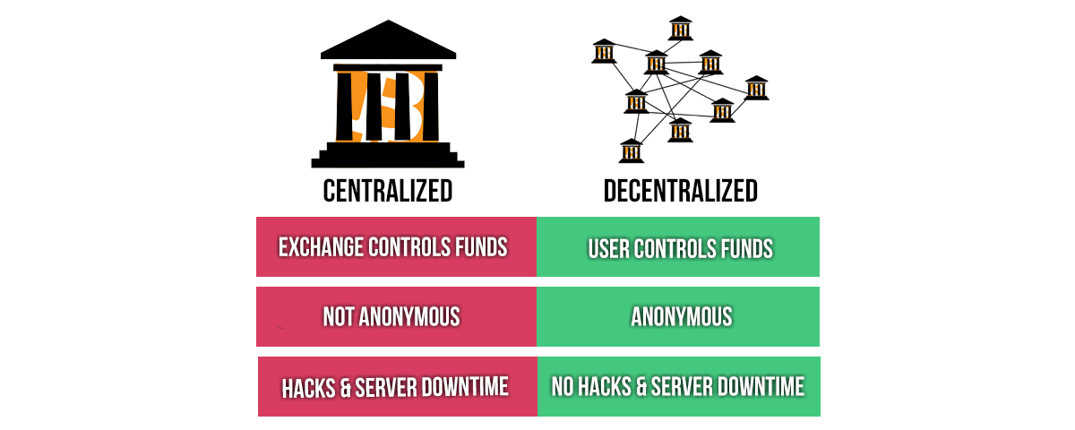
Benefits

Slide 4
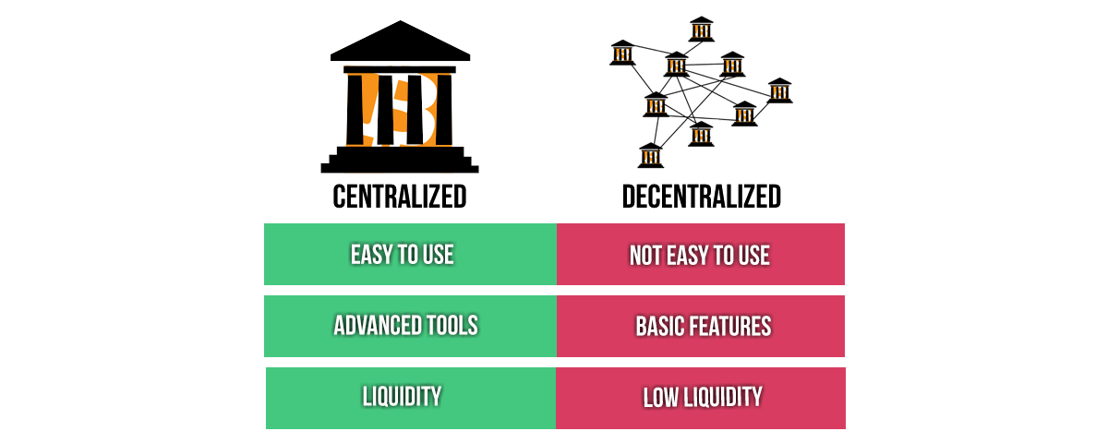
Disadvantages

Slide 5
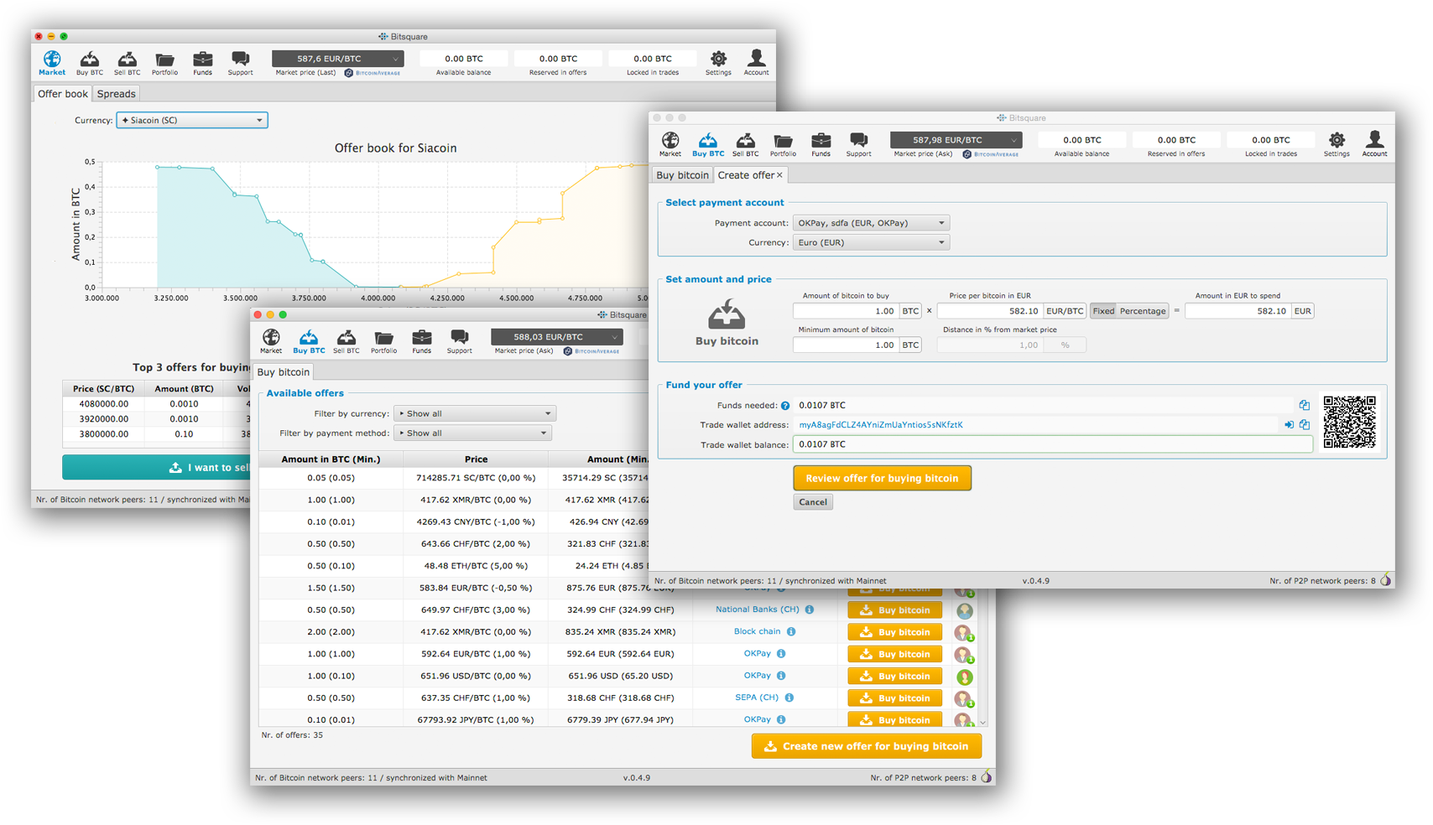
Example: bisq (formerly Bitsquare)
Notes:
https://bisq.network/

Slide 6
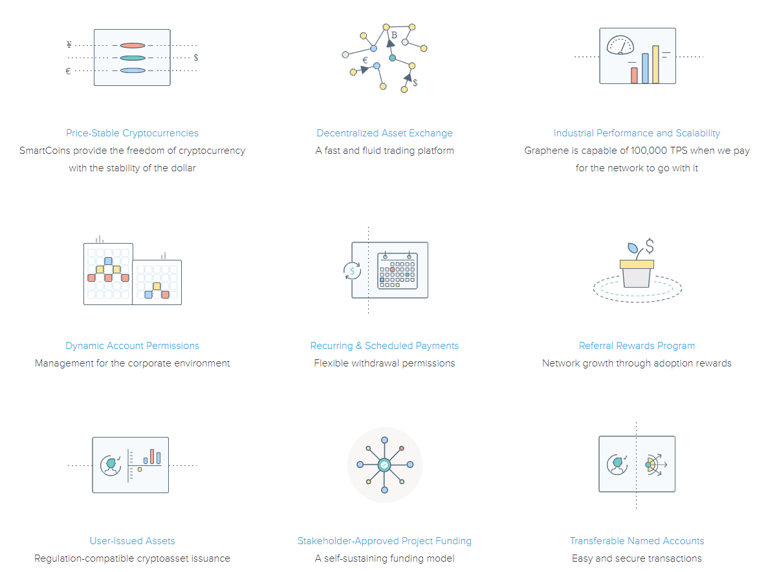
Underlying Crypto: BitShares
Notes:
https://bitshares.org/
https://www.cryptofresh.com/

Slide 7
Other Examples
Airswap
OmiseGO
Kyber Network
Etherdelta
IDEX
OasisDex
Bancor
OmegaOne
And many more …
BarterDEX
NXT
CounterParty (runs on btc tx)
Waves
EasyDEX
PAX
SuperNET
Komodo
0x

Slide 8
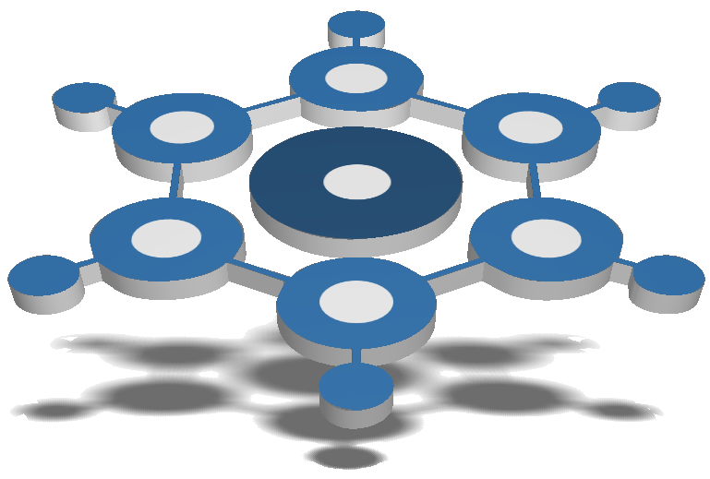
CryptoBridge
Runs in Browser, Windows or MacOS
Uses underlying BridgeCoin (minable, 60s, scrypt)
Holders of BridgeCoin get 50% of exchanges profits
Only you hold your private keys (no one can help)
No central point of failure (p2p connections)
Kinda easy enough to use, main issue is low volume!
https://crypto-bridge.org/
Notes:
https://crypto-bridge.org/
https://bridgecoin.org/

Slide 9
Thank you for your Attention
Questions?
Ask at Bitcoin & Liberty Meetup Hannover at BlockChainLocation.de
https://www.meetup.com/Hannover-Bitcoin-Liberty-Meetup/

